Slide 1



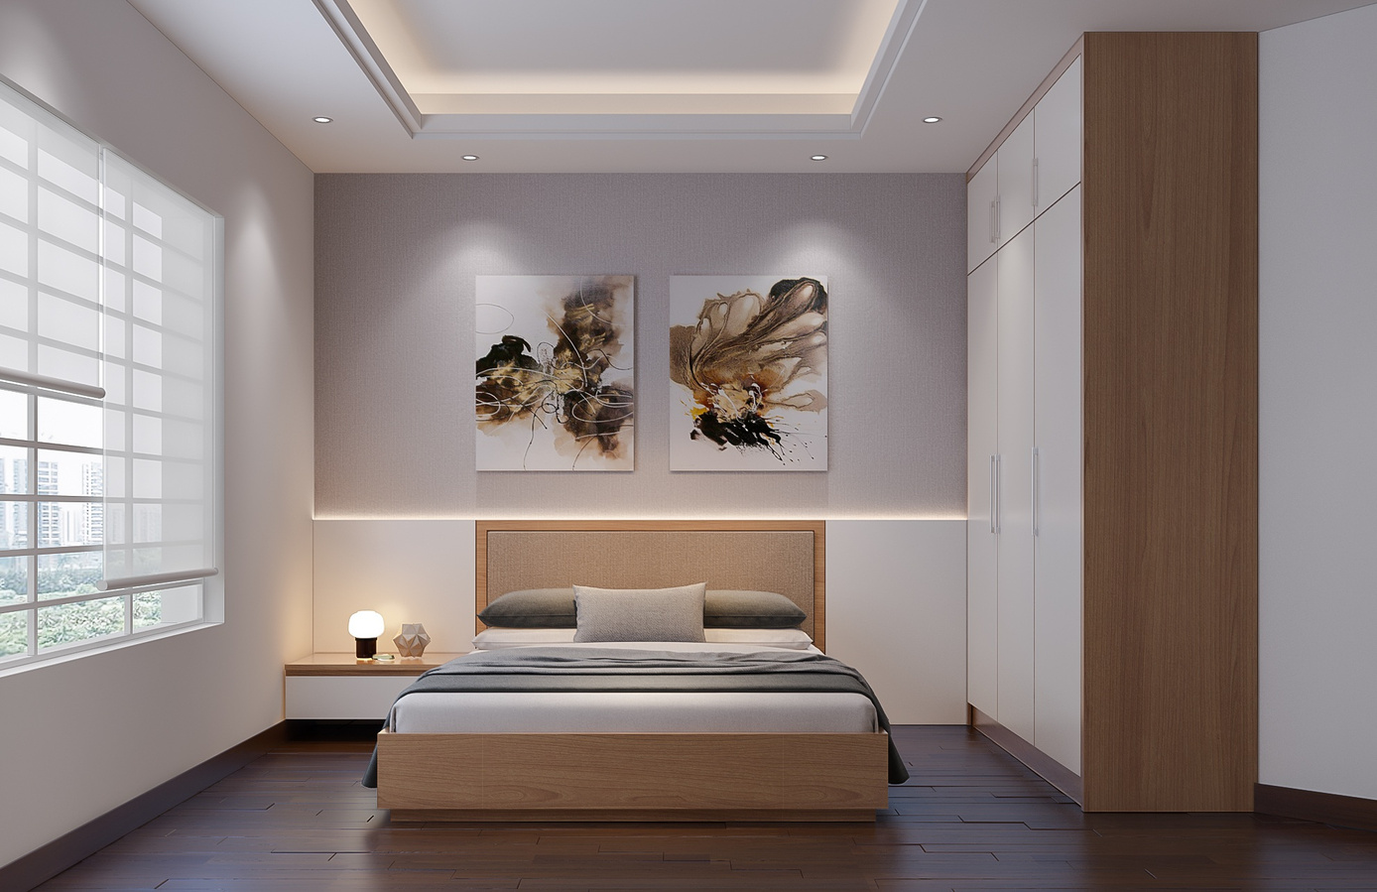



ModifAI
Project Update 4
Overview of progress and future plans for our AI-powered interior decor app

Slide 2






Team Introduction for ModifAI Project Update 2
Akram Hossain Apu Khan – 2231090642
Mehedi Hasan Dip – 2232167042
Together, we are transforming interior decor through AI technology.
Hacibull Hashan Tosher – 2111626642

Slide 3




Exploring Four Key Concepts of ModifAI's Impact
AI transforms traditional interior decor processes into streamlined experiences.
Personalized suggestions enhance user satisfaction and design effectiveness.
Efficient decor solutions save time and resources for users.
User-friendly interfaces ensure accessibility for all demographics.

Slide 4



This Week's Progress Update
This week, we successfully connected ModifAI with Firebase, enabling secure data storage and user authentication. The signup and login pages are now fully integrated into the Firebase database, providing users with a seamless experience. This integration allows us to manage user data efficiently and enhances the overall functionality of our app. As we move forward, we will focus on optimizing these connections to ensure the app remains responsive and user-friendly.

Slide 5

Current Challenges in ModifAI
Our team is currently facing significant challenges with writing and reading user data from the Firebase database. This issue is impacting user experience, as our app's functionality relies heavily on seamless data management. It's crucial to address these matters promptly to ensure that users can efficiently interact with their personalized decor suggestions. Our goal is to resolve these issues quickly and effectively to enhance the overall performance and reliability of ModifAI.

Slide 6
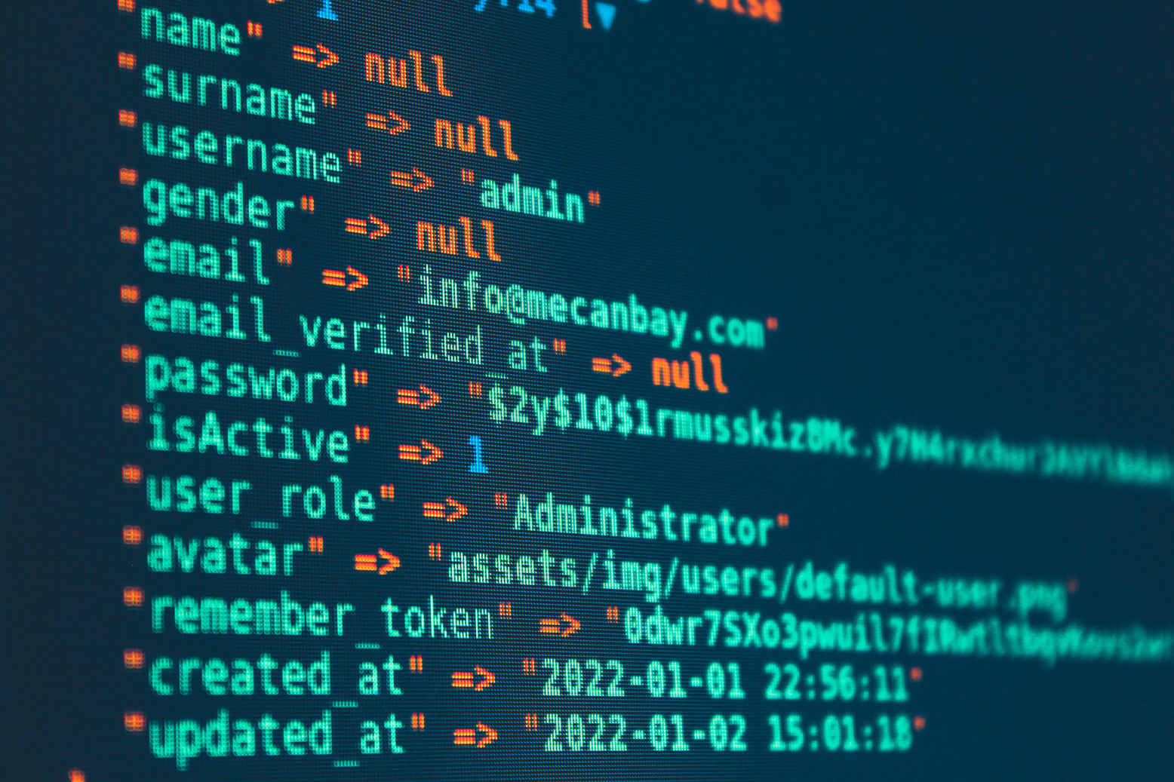
Next Steps for ModifAI
To ensure the success of ModifAI, our immediate focus is to fix the database read/write issues that hinder user data management. Once these issues are resolved, we will focus on integrating machine learning capabilities to enhance user experience. This integration will provide users with smarter and more personalized decor suggestions, making the app not only efficient but also more intuitive. These improvements are essential for the app's overall functionality and will significantly elevate our project in the competitive landscape.

Slide 7

Conclusion and Future Enhancements
ModifAI is advancing quickly with various new integrations and improvements. Our focus is on enhancing the user experience through added features and more sophisticated AI capabilities. As we move forward, we will prioritize seamless interactions and personalized decor suggestions to cater to individual tastes more effectively. The journey ahead looks promising as we strive to redefine interior decor with our innovative approach and commitment to excellence.

